Slide 1
UK Oil & Gas Investments PLC
Horse Hill: Is the Kimmeridge a game changer?

Slide 2
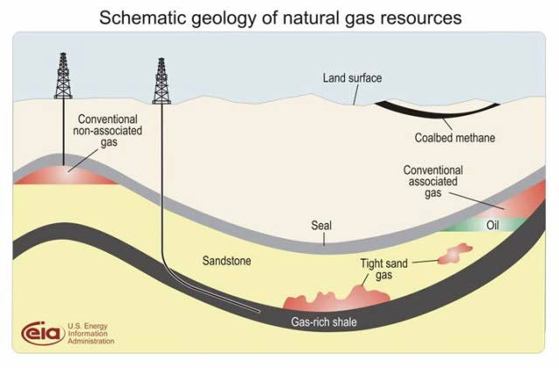
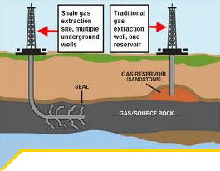
Oil and Gas Accumulations: Types
Source: USA EIA and UKOOG

Slide 3
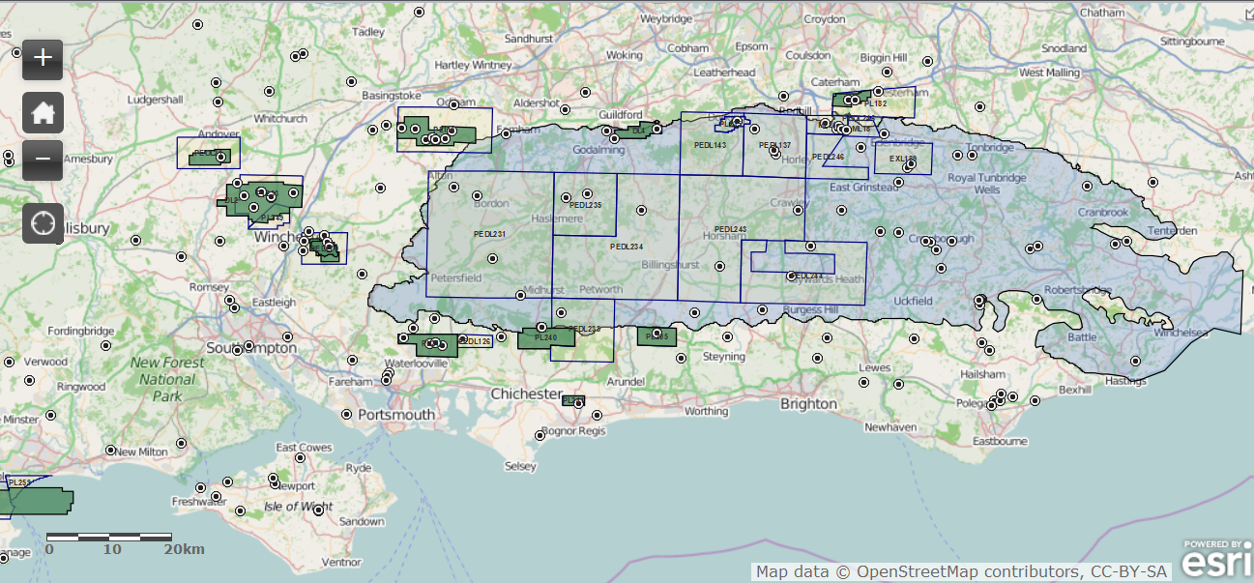
Weald & IoW Basin: UKOG interests, Fields,Wells
Brockham Field
Horse Hill Field PEDL 137/246 140 km sq (36000 acres)
Baxters Copse Discovery
Horndean and Markwells Wood Fields
IoW P1916
Grey=BGS shale potential area
Brockham Field
IoW 14th Round
Application
Source: DECC, UKOG, ESRI

Slide 4
Weald Basin Creaming Curve
Horse Hill: typical Weald conventional field – Bread & Butter
Biggest Portland Sandstone field 5-12+ Million bbl OIIP
Step change needs new play concept i.e. Triassic, Kimmeridge
UKOG Field Interest
Horse Hill 2014
Source: BGS and UKOG

Slide 5
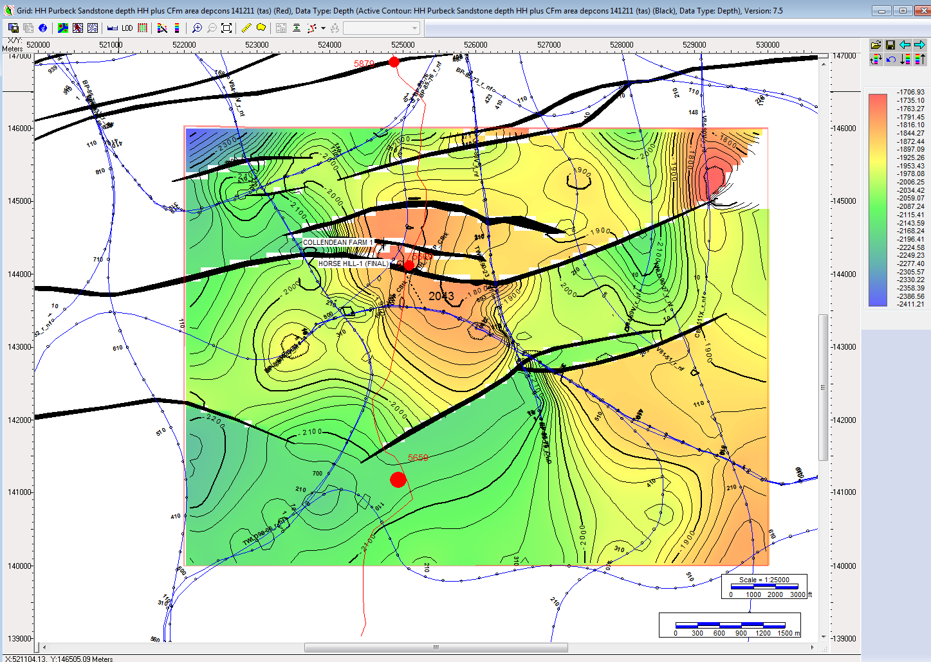
Horse Hill U. Portland Field: Bread & Butter
CF-1
Lowest Known Oil 1900 ft tvdss
HH-1
Maximum Closure
~1960-1980ft
Source: UKOG

Slide 6
Distribution of Kimmeridge Clay (“KC”)
KC Lies immediately below Portland and time equivalent rocks
N. Sea- World Class source rock- generated 2 trillion bboe, discovered 50 billion bbl
Current Weald Paradigm: rich source rock not cooked enough to generate much oil/gas except in w. basin centre
Green - offshore Central & Viking Graben Systems
Purple – onshore Weald, Wessex & IoW
Red – Oil and gas fields
Horse Hill
KC
UKOG IoW
KC
Source: Kimmeridge Energy, UKOG

Slide 7
Kimmeridge at Dorset Coast
Source: Celtique Energy

Slide 8
Kimmeridge Micrite: Hybrid Oil Play
Horse Hill: 1500 ft gross KC
2 limestones with porosity c. 100 ft gross thick
Encased in highly organic rich thermally mature source rock
Oil saturations in upper limestone
Balcombe oil generated from KC
@3000 ft MD 5.83% TOC,
S241mgHC/g
HI 699
Source: UKOG, Bryneich

Slide 9
HH KC Geochemistry vs BGS 2014
HH KC - very rich source rock particularly in middle section between limestone reservoir units
TOC 4.64-9.4%, 2715-3345 ft tvdss encasing limestones
Generative Potentials V. High 45-103 kg/tonne
BGS 2014 Weald Shale report data
HH Kimmeridge Clay Sample Analyses
Source: BGS 2014, UKOG

Slide 10
HH Kimmeridge is Different to N. Sea/Wessex – major impact on source maturity modelling
HH Kimmeridge Clay Sample Analyses HI 759-1098
W. Africa/Brazil, E & C African Rifts, S. Atlantic
Kimmeridge N. Sea, Lias Wessex basin
(Carboniferous Coal
Measures SNS)
Source: BGS 2014, UKOG

Slide 11
KC Thermal Maturity post HH-1
Source rock: sedimentary rock rich in organic matter which, if subjected to sufficient heat and pressure over geological time, will generate oil or gas.
Normally >1-2% organic matter (TOC)
Thermally mature: source rocks which have received sufficient temperature and pressure over geological time to generate hydrocarbons (defined as vitrinite reflectance (Ro) >0.5%)
HH Kimmeridge Clay Ro 0.62-.81
BGS 2014 Ro <0.6
Source: UKOG, NuTech

Slide 12
HH-1 KC Thermal Maturity vs BGS 2014
Horse Hill changes the current KC Paradigm
HH-1: ~1300 gross ft of thermally mature Kimmeridge Clay organic rich shale Within early to peak oil generation window
Source: BGS 2014, UKOG

Slide 13
UKOG Horse Hill: What Next?
Proof of Concept
Complete Geochemical Analyses
Nutech electric log, rock mechanics and OIIP analyses
Well trade for Balcombe core data
HH Flow test
  Presence of natural fractures ?
Determine whether:
  KC oil limit defined by an oil water contact (i.e. conventional trap) or
  Ubiquitous where KC limestone porosity lies within mature KC source rock (i.e. hybrid play)
  KC Shale potential (i.e. unconventional)
Economic viability
Source: Kimmeridge Energy

Slide 14
Kimmeridge Could Make a Difference!
UK vs. USA Oil Production
Source: Kimmeridge Energy

